Slide 1
SEP203 - Test Plan
Aishwarya Sharma, Gaurav Jawla, Hema Ramachandran, Zixu Wang

Slide 2
Testing strategy
Unit Testing
Integration Testing
Functional Testing
Acceptance Testing
Verifies individual unit of code
Verifies combination of individual modules
Verifies if the specification meets the requirements
User decides if the correct product is build

Slide 3
Frameworks
Jest for backend
Jest provides code coverage by using –coverage flag
Jest, Jest-cucumber for front-end when we run it.
Goal to have code coverage of at least 85%
We plan to use Travis CI for integration testing and code coverage/code quality/bugs/vulnerabilities.
We installed Beautify, Prettier extensions to keep our code formatting similar.
IDE : VS Code (all team members)

Slide 4

Bug report protocol
Submit an issue when a bug is discovered using bug report template
Everyone in the team will verify the bug and a person will be assigned to fix it
Pull request to fix the bug must be reviewed by person who found the issue

Slide 5
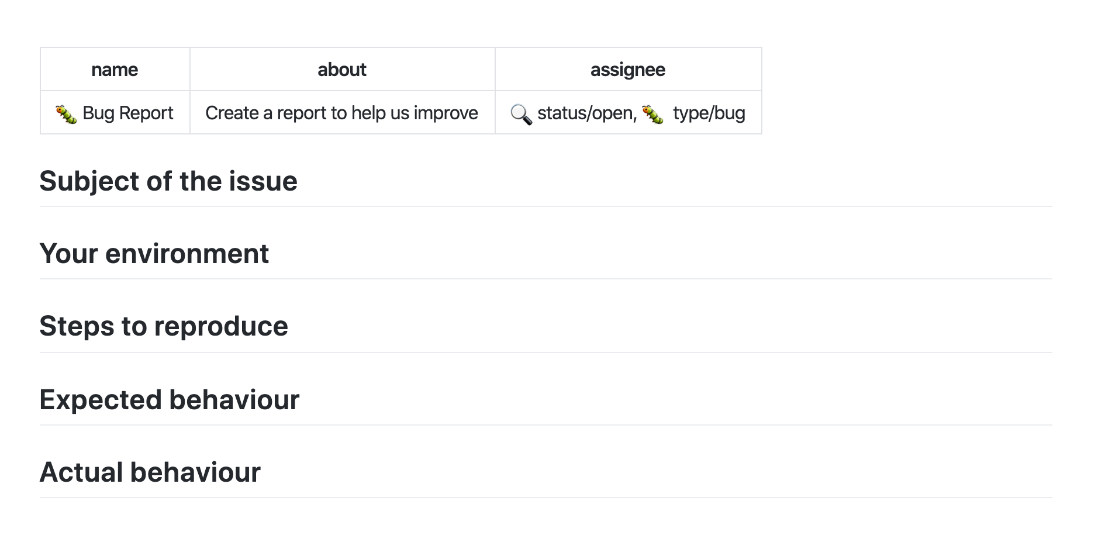
Bug template

Slide 6
Thanks!

